Slide 1
Predicting Optimality of
Network Paths
Team #6
Aditya | Alok | Ankit | Dhara | Dhyey | Karthik | Shubham
Notes:
Predicting optimality of Network Paths/ Mapping The Internet

Slide 2
Problem Statement
Given a chronological series of n graphs, predicting the probability of optimality of paths in future k graphs
(If I have a known optimal way to reach the goal, can I predict if it will stay optimal?)
Notes:
In our case, n=15, k=5

Slide 3
Business Value - Problem
Mapping a large, dynamic graph (viz. internet) is an expensive operation
More so, when the optimal path also has to be computed
Objective of our project is to avoid that by using past information to predict future optimal paths rather than recalculating them
At a given point of time, assuming the nodes remain the same, we can say with certain confidence which optimal route we should take in the future

Slide 4
Data Preprocessing
Reduced the size from 350K entries to 37k entries
Fingerprinting
Generation of fingerprints of a string is a three stage process;
From standard string generate n-grams
Use rolling hash function to generates the hash values for each n-gram
Use winnowing to generate the fingerprints from the hash values
Assigned Numbers to unique fingerprints
Notes:
Training + Validation + Test (10+2+3)

Slide 5
Why This is Important
Before
ASVHC1 - Arlington Arlington Hospital ASVHC1 - &%Arlington ASVHC1 - Arlington - Hospital Arlington ASVHC1 - Arlington Hospital
After
1acghilnorstv

Slide 6
Benchmarking
Calculating Historical Mode to match benchmarking
Benchmark - Takes the mode over the 10 training graphs.
If the given path is optimal in the graph, it receives a value of 1. If not, it gets a 0.
Notes:
Naive model

Slide 7
Features
 | Timestamp1 | Timestamp2 | Timestamp3 | Timestamp4 | Timestamp5 | Timestamp6 | Timestamp7 | Timestamp8 | Timestamp9 | Timestamp10 | Timestamp11 | Timestamp12
Path1 | 0 | 0 | 0 | 0 | 0 | 0 | 0 | 0 | 0 | 0 | 0 | 0
Path2 | 1 | 1 | 1 | 1 | 1 | 1 | 1 | 1 | 1 | 1 | 1 | 1
Path3 | 0 | 0 | 0 | 0 | 0 | 1 | 0 | 1 | 0 | 0 | 0 | 0
Path4 | 1 | 1 | 1 | 0 | 1 | 1 | 1 | 0 | 0 | 1 | 1 | 1

Slide 8
Algorithms
Markov Chain
Random Forest
Gradient Boosting Machine
Logistic Regression
Used Weighted Decay during feature extraction
Notes:
Might try: Gradient Boosting Machine, MARS

Slide 9
Methodology
 | Timestamp1 | Timestamp2 | Timestamp3 | Timestamp4 | Timestamp5 | Timestamp6 | Timestamp7 | Timestamp8 | Timestamp9 | Timestamp10 | Timestamp11 | Timestamp12 | Prediction
Path1 | 0 | 0 | 0 | 0 | 0 | 0 | 0 | 0 | 0 | 1 | 0 | 1 | 0.3333333333
Path2 | 1 | 1 | 0 | 0 | 0 | 0 | 1 | 0 | 0 | 0 | 1 | 0 | 0.3333333333
Path3 | 0 | 0 | 0 | 0 | 0 | 0 | 0 | 1 | 0 | 0 | 0 | 0 | 0.1666666667
Path4 | 1 | 1 | 1 | 1 | 1 | 1 | 1 | 1 | 1 | 1 | 1 | 1 | 0.9230769231
Path5 | 0 | 0 | 0 | 1 | 0 | 0 | 0 | 1 | 1 | 0 | 0 | 1 | 0.4
Path6 | 0 | 0 | 0 | 1 | 0 | 0 | 0 | 0 | 0 | 0 | 0 | 0 | 0.1666666667

Slide 10
Markov Chain
AUC Values using threshold of 0.3:
13 : 0.803355943468
14 : 0.776529124256
15 : 0.78091871177
Mean Value - 0.786934593165
Notes:
Used because uses previous values to predict answer
Results beat the benchmark marginally

Slide 11
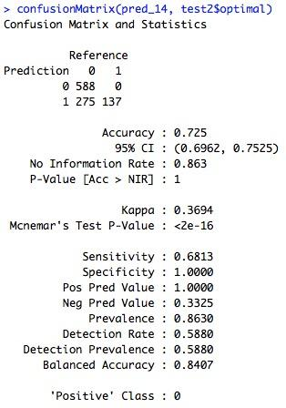
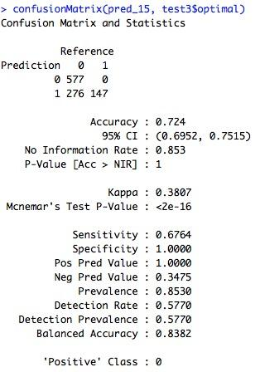
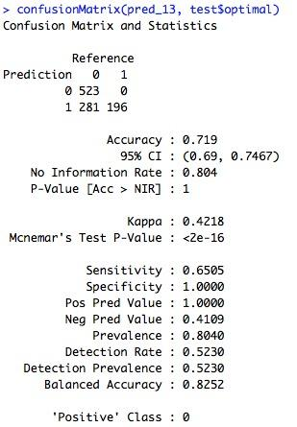
Gradient Boosting Machine
Notes:
Boosts gradient by creating intermediate decision trees
Better accuracy than Markov’s

Slide 12
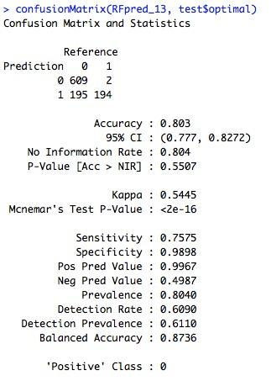
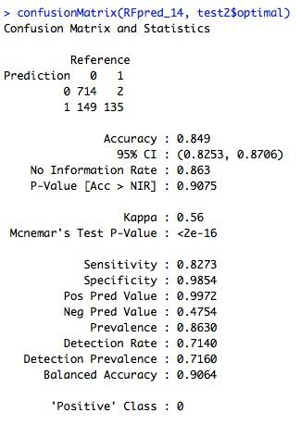
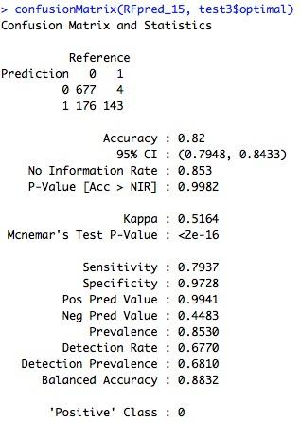
Random Forest
Notes:
This black box methods seems to work well on our data
Best accuracy till now
Nearly as good as Kaggle top 5 result with just basic weighted feature

Slide 13
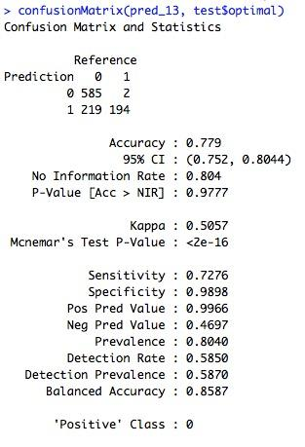
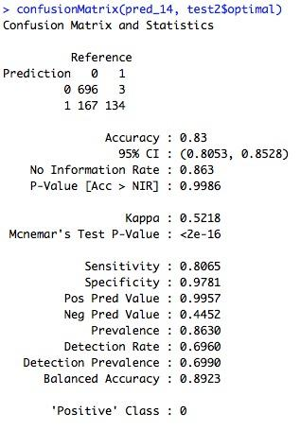
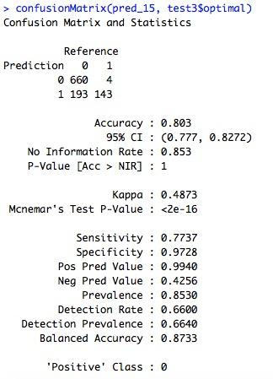
Logistic Regression
Notes:
Basic classification; beats the benchmark, and Markov

Slide 14
Business Value - Solution
Reduce CPU cycles for new path calculations
Although not really user centric, this is a problem large corporations might face
Data centers, server farms
Any social network - be it Facebook, LinkedIn or Pinterest - would be interested in knowing the optimal path based on previous instances instead of calculating it at every instance

Slide 15
Thank You

Slide 16
References
https://www.kaggle.com/c/facebook-ii
Prediction and Smoothing for partially observed Markov Chains, Mats Rudemo.
https://pypi.python.org/pypi/fingerprint/0.1.1
http://networkx.github.io/documentation.html

